Slide 1


WELCOME TO
CORSAIR CONNECT
OPPORTUNITY FOR
A BETTER WORLD

Slide 2




In this presentation
The problem
Plastic Waste
The solution
Corsair Group International
The revolution
CSR Plastic Credit
The opportunity
Corsair Connect
We are independent partners, not financial advisors.
The service offered by Corsair is that of a plastic waste removal service and is thus not a financial product.
The CSR plastic credit is provided as evidence of support for the combined mission of Corsair Connect and the Corsair Group.
To remove plastic waste from our environment. As such, no financial license is required for its acquisition.

Slide 3
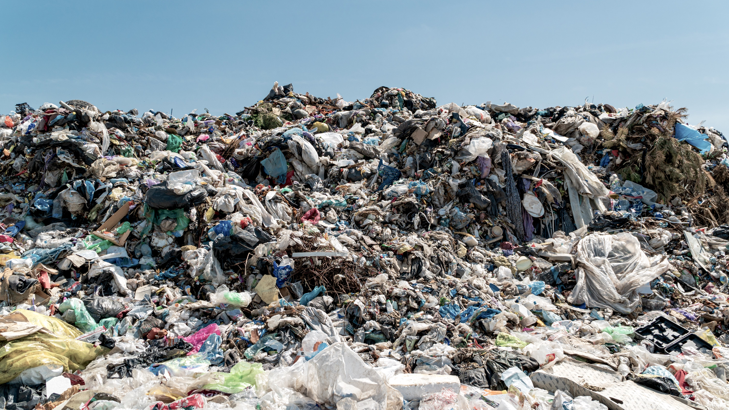
The plastic pollution
is devastating,
but we have the solution.

Slide 4

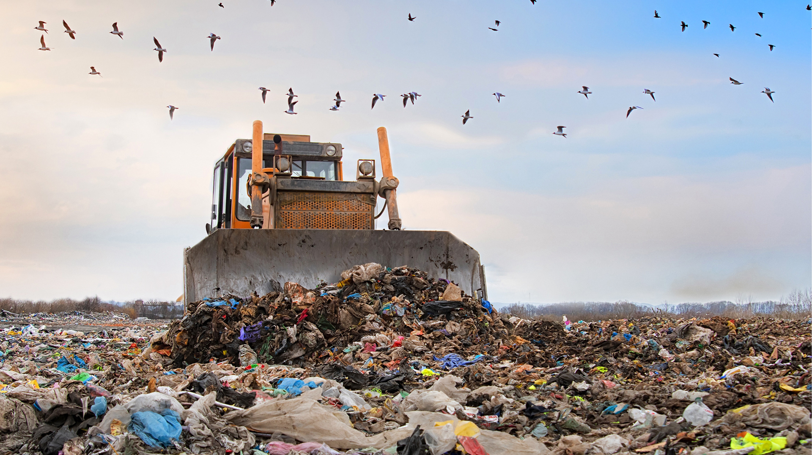

The problem

Slide 5
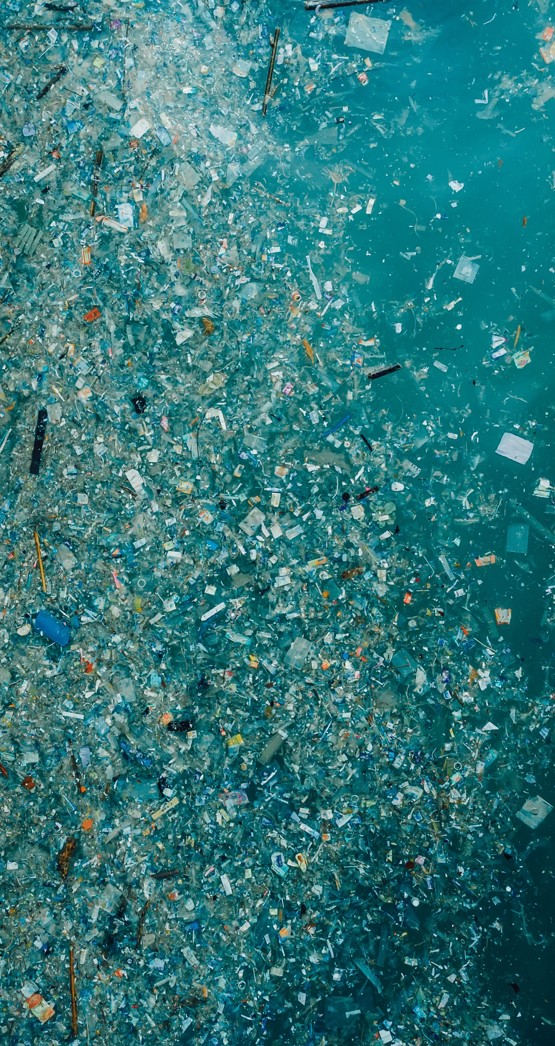
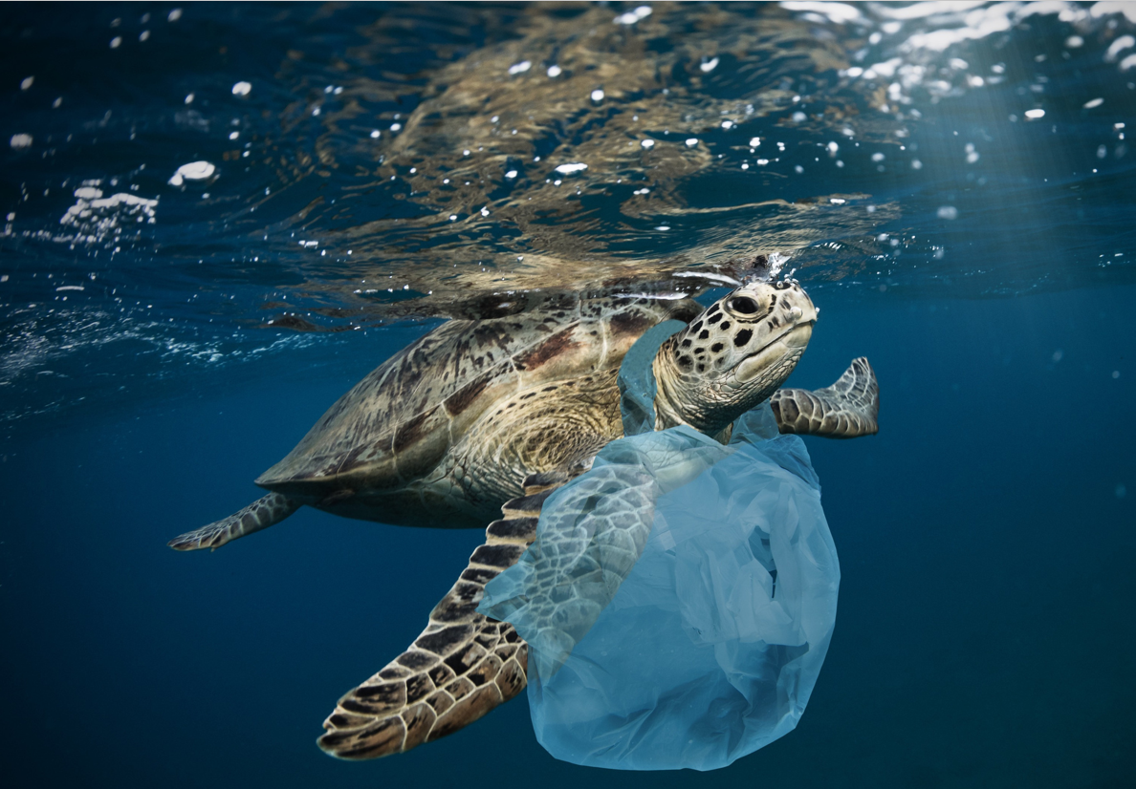
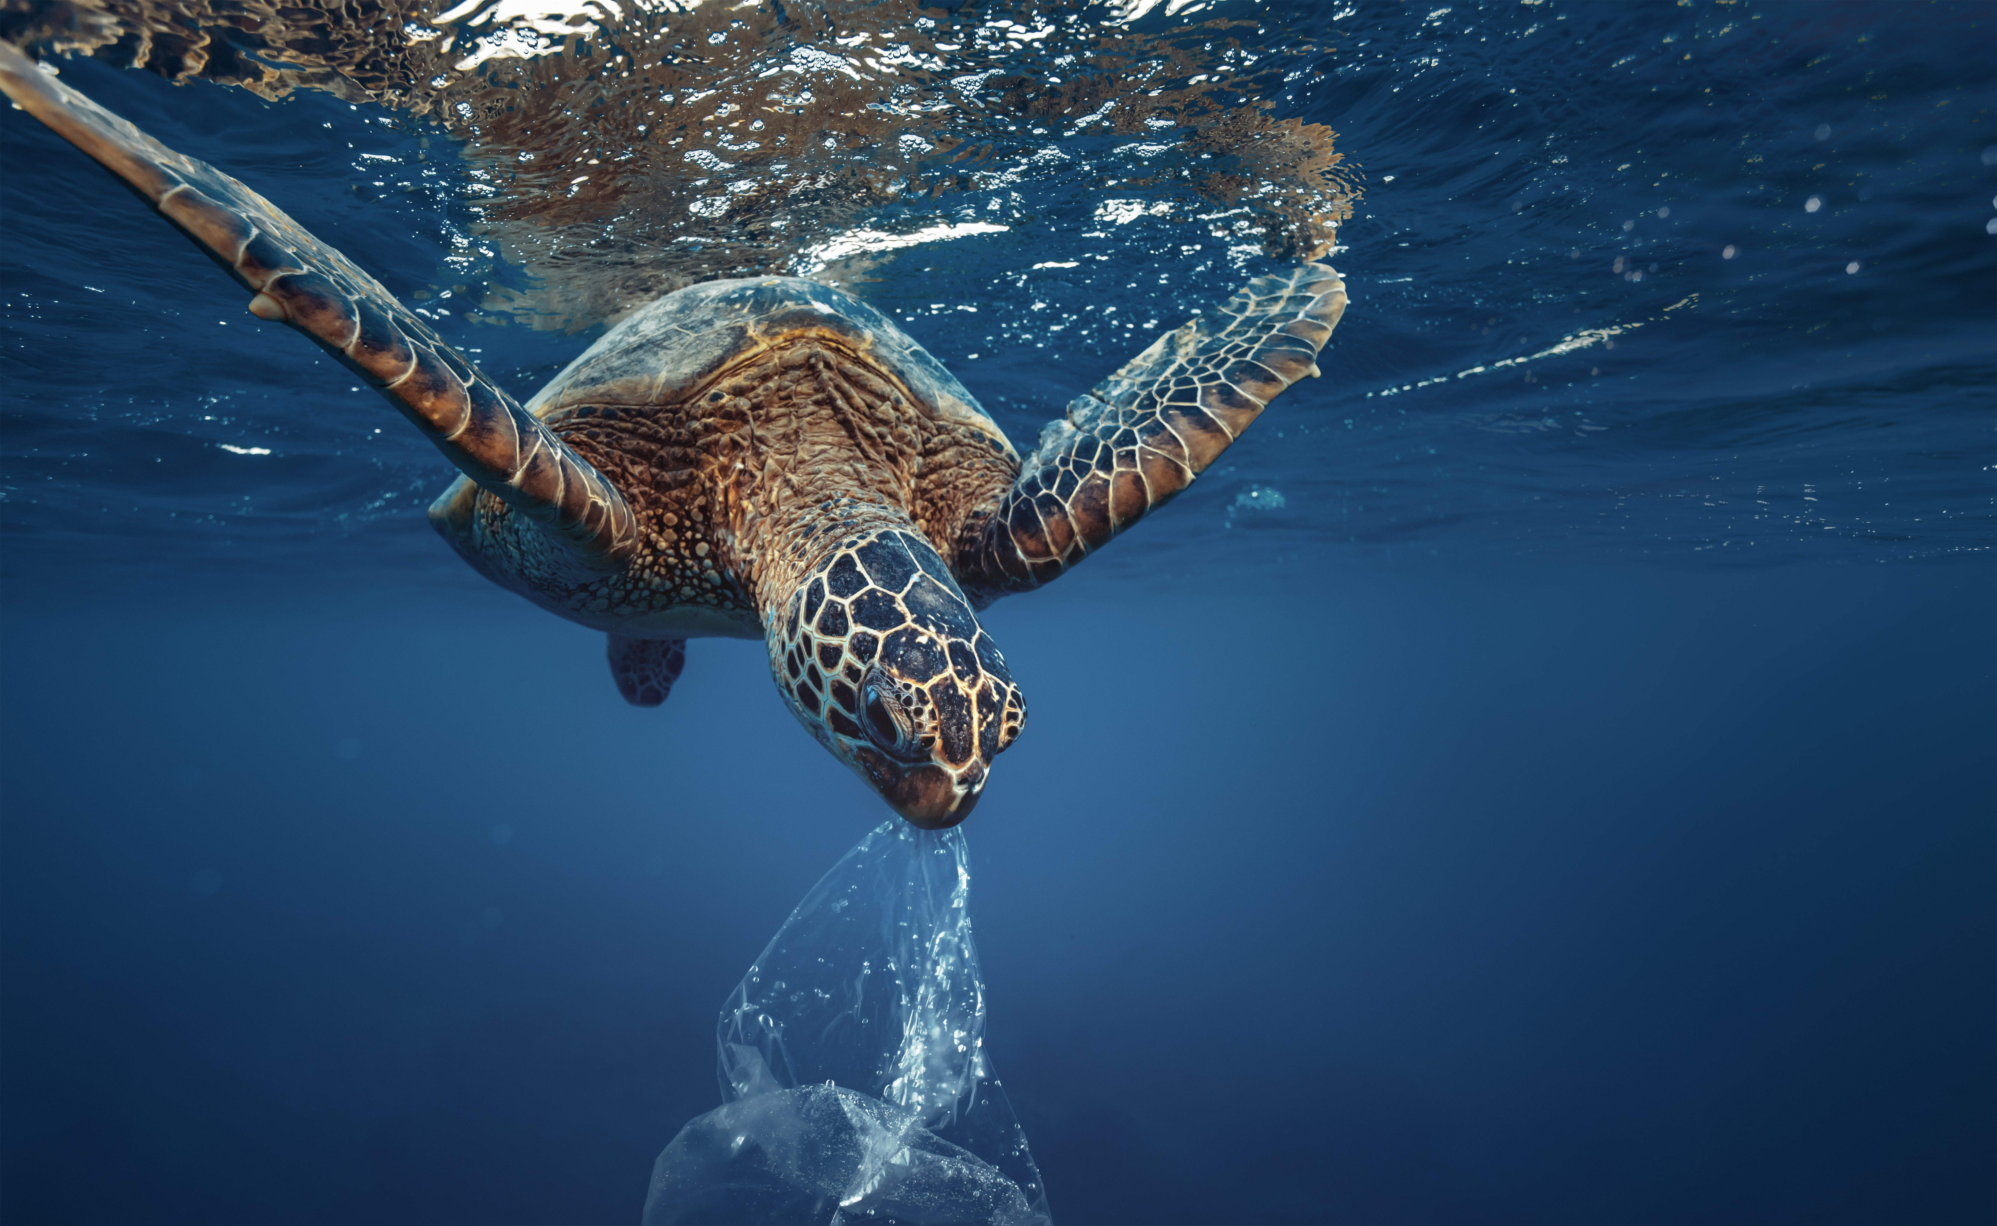
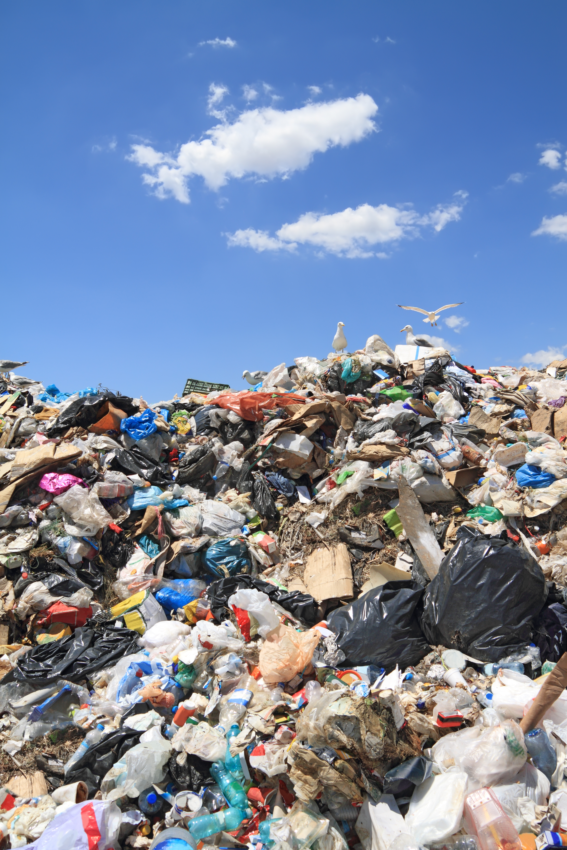
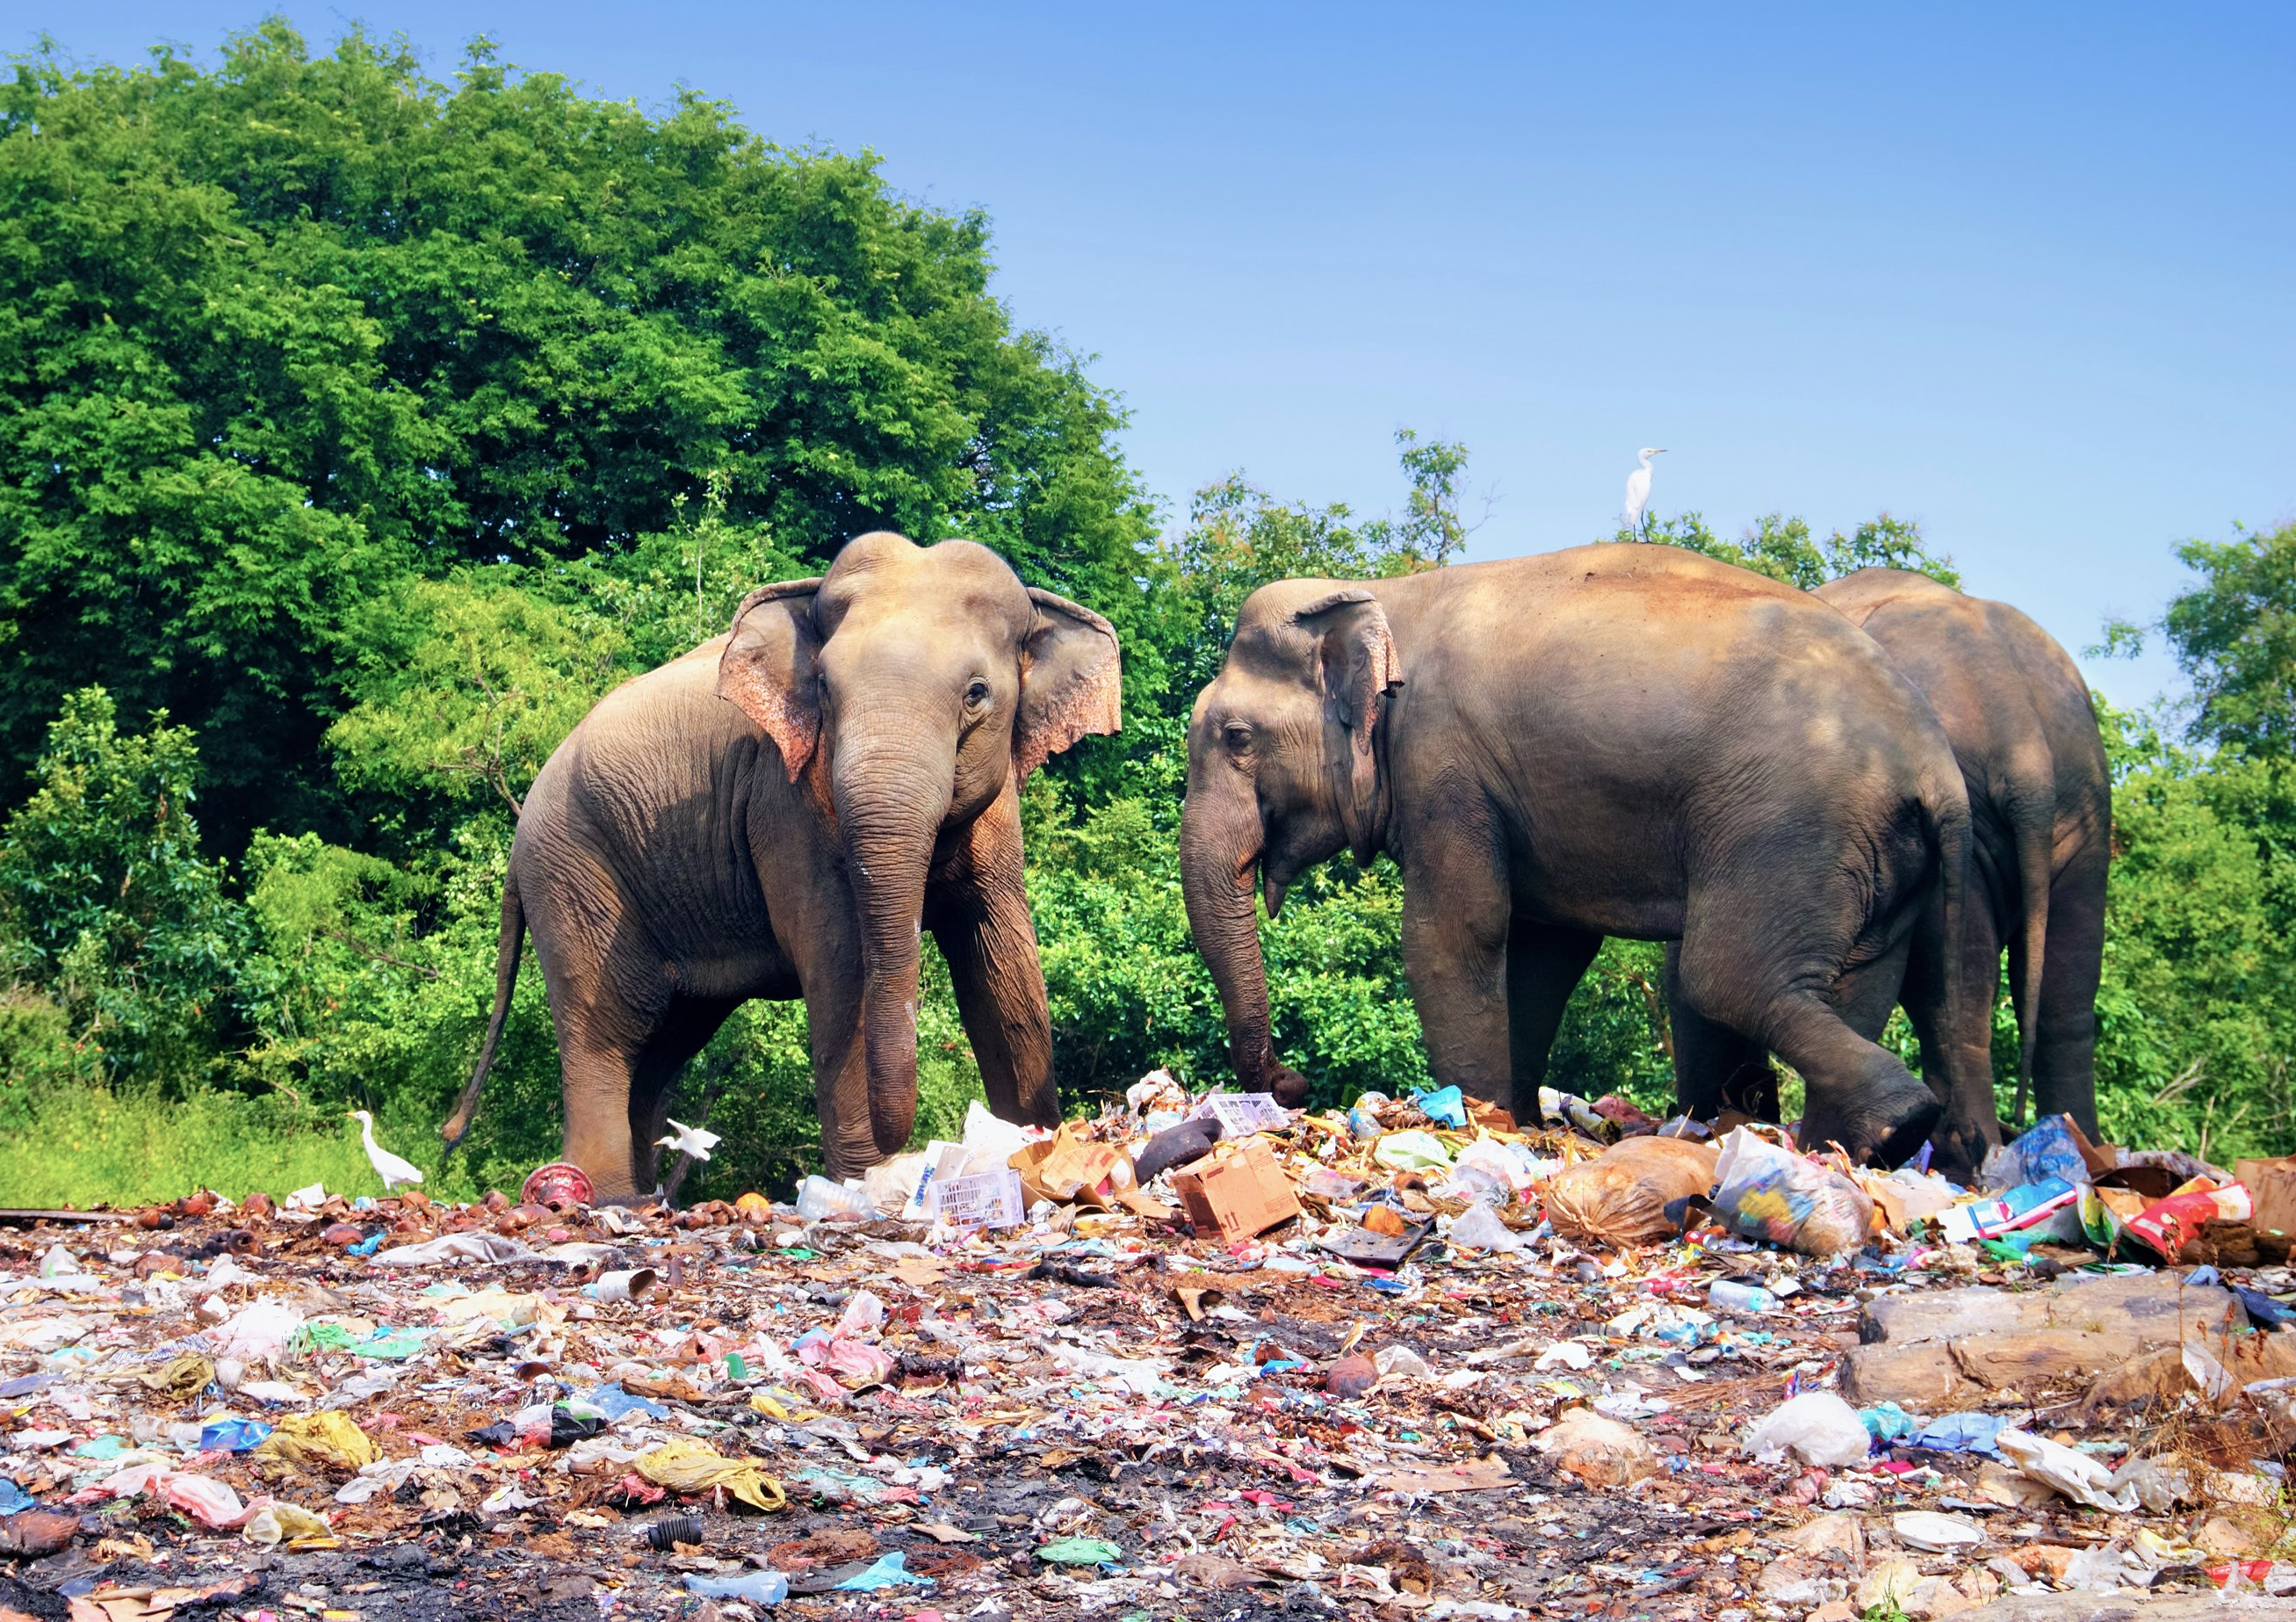
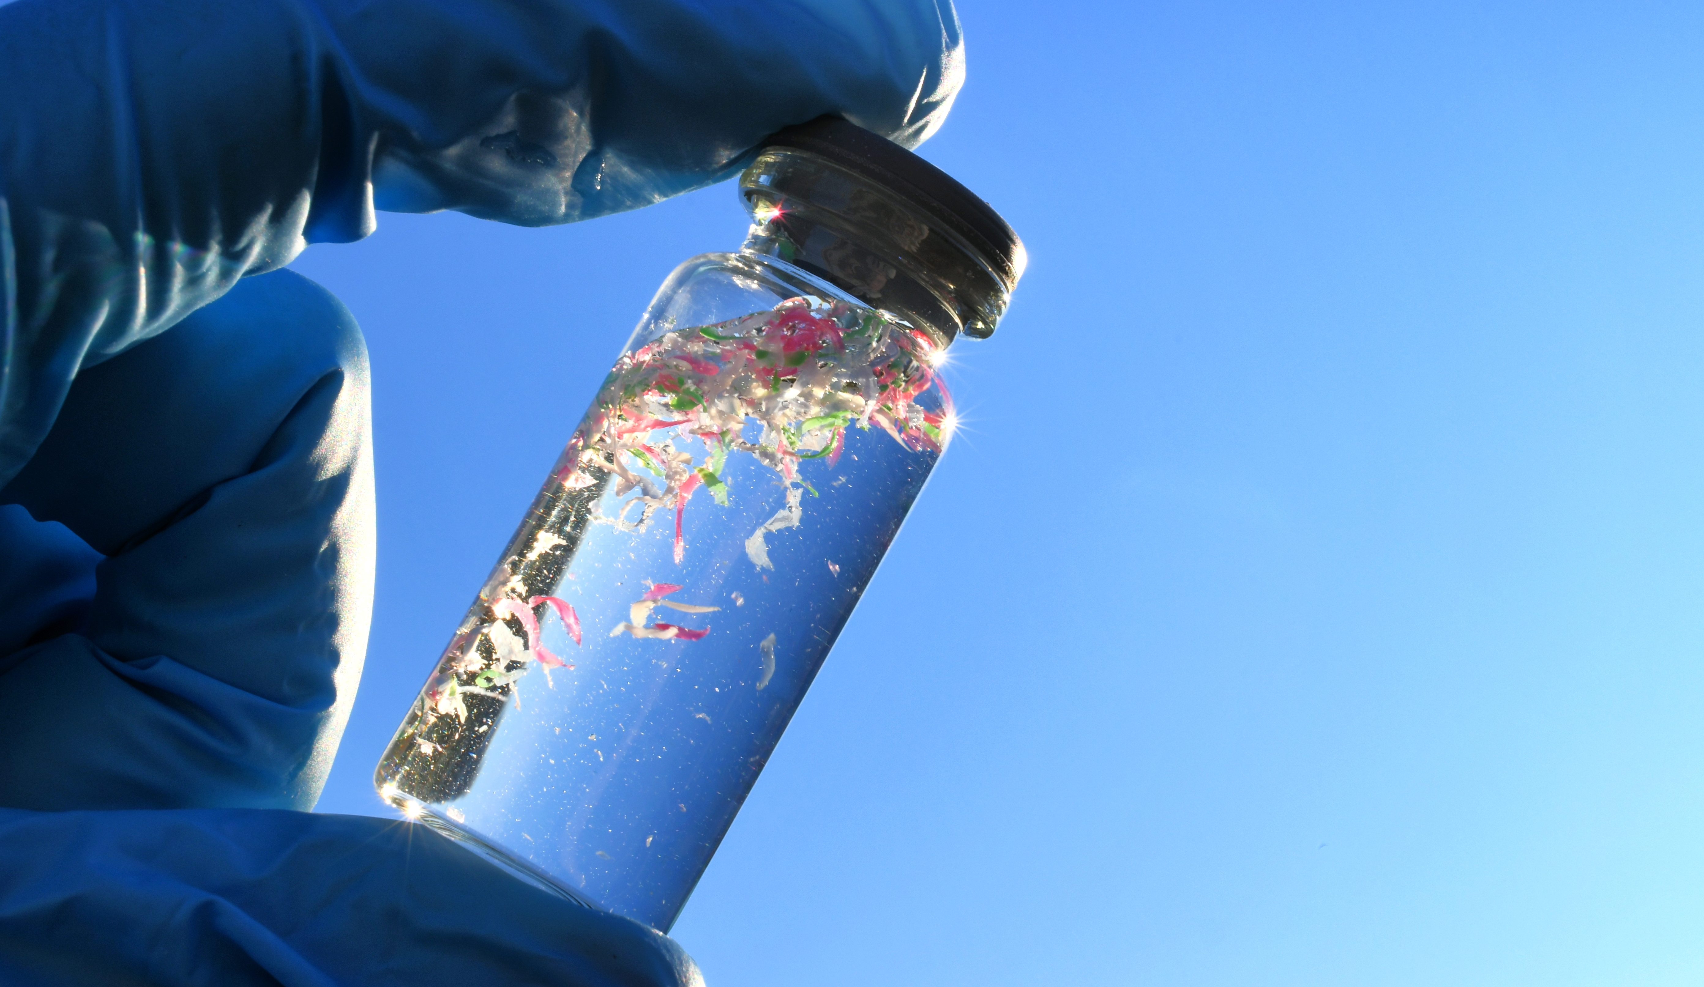

Slide 6
Estimated time
to break down
500 years
500
400
300
200
100
0
450 years
450 years
200 years
50 years
Styrofoam cup
Aluminium can
Nappy
Plastic bottle
Plastic toothbrush
Source: NOAA / Woods Hole Sea Grant

Slide 7

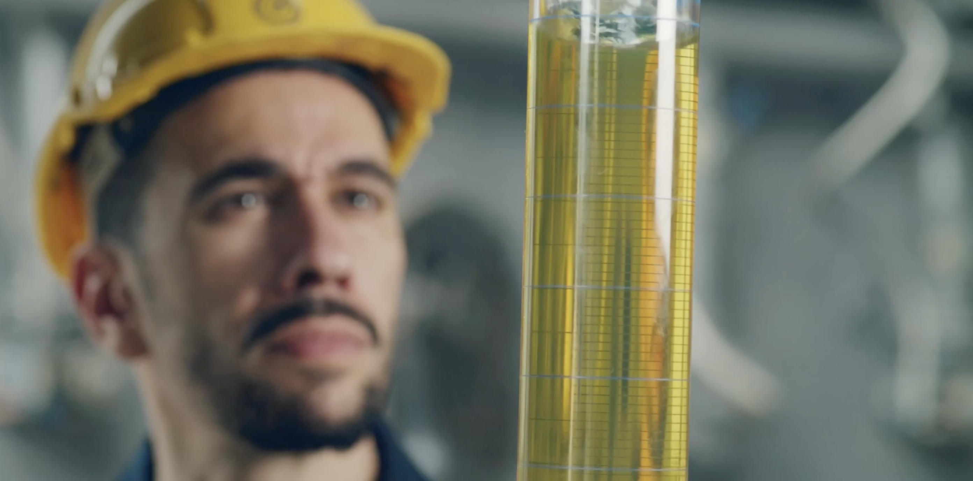
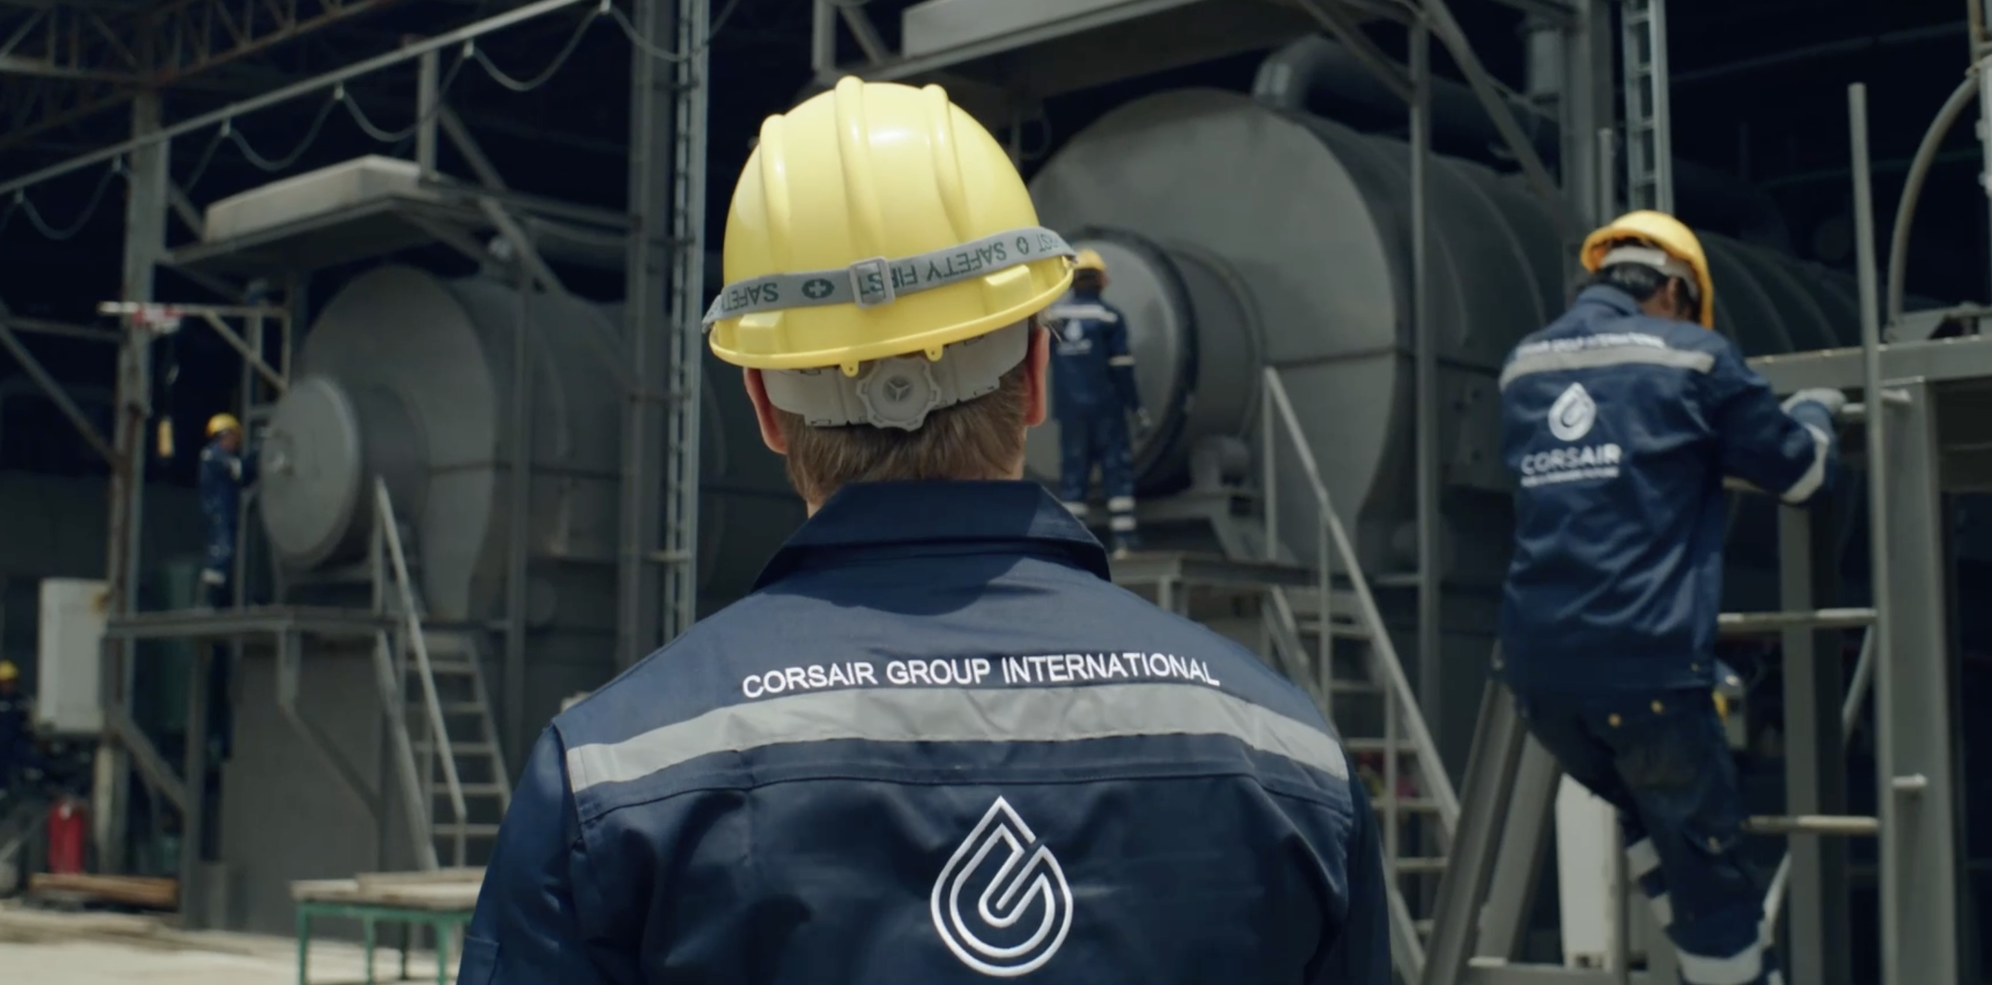

The solution
Corsair Group International
Transitioning to a circular economy
Corsair transforms plastic waste into advanced bio-oil, also known as pyrolysis oil. This is then used to manufacture
the plastics we need in our daily lives.
By providing much needed solutions to global environmental problems such as plastic waste, air pollution and water pollution, Corsair is playing an important role
in the creation of a circular economy.
Sustainable solutions for the pollution of the planet.

Slide 8

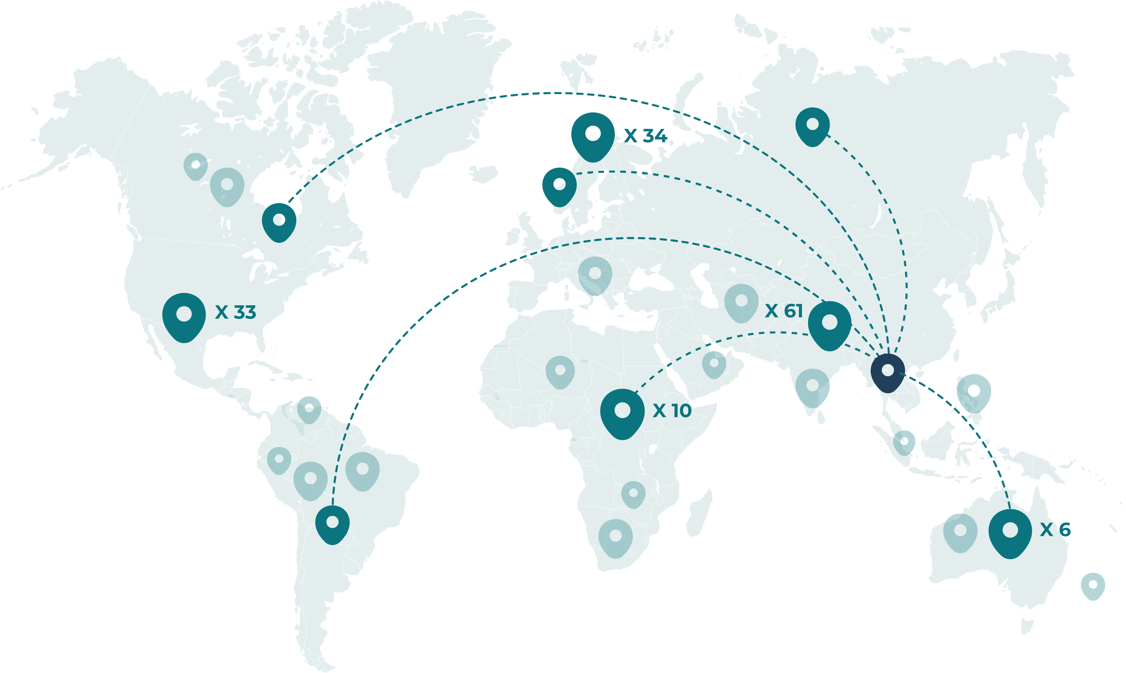
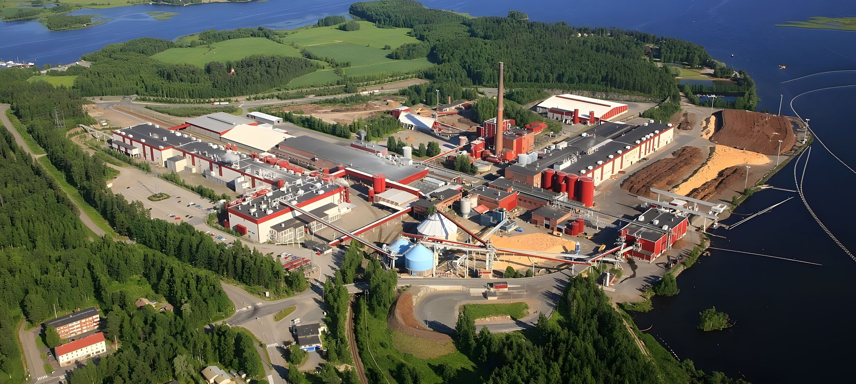
Expansion plan for 2030
Corsair
is building facilities all over the world
Kaipola facility, Finland

Slide 9


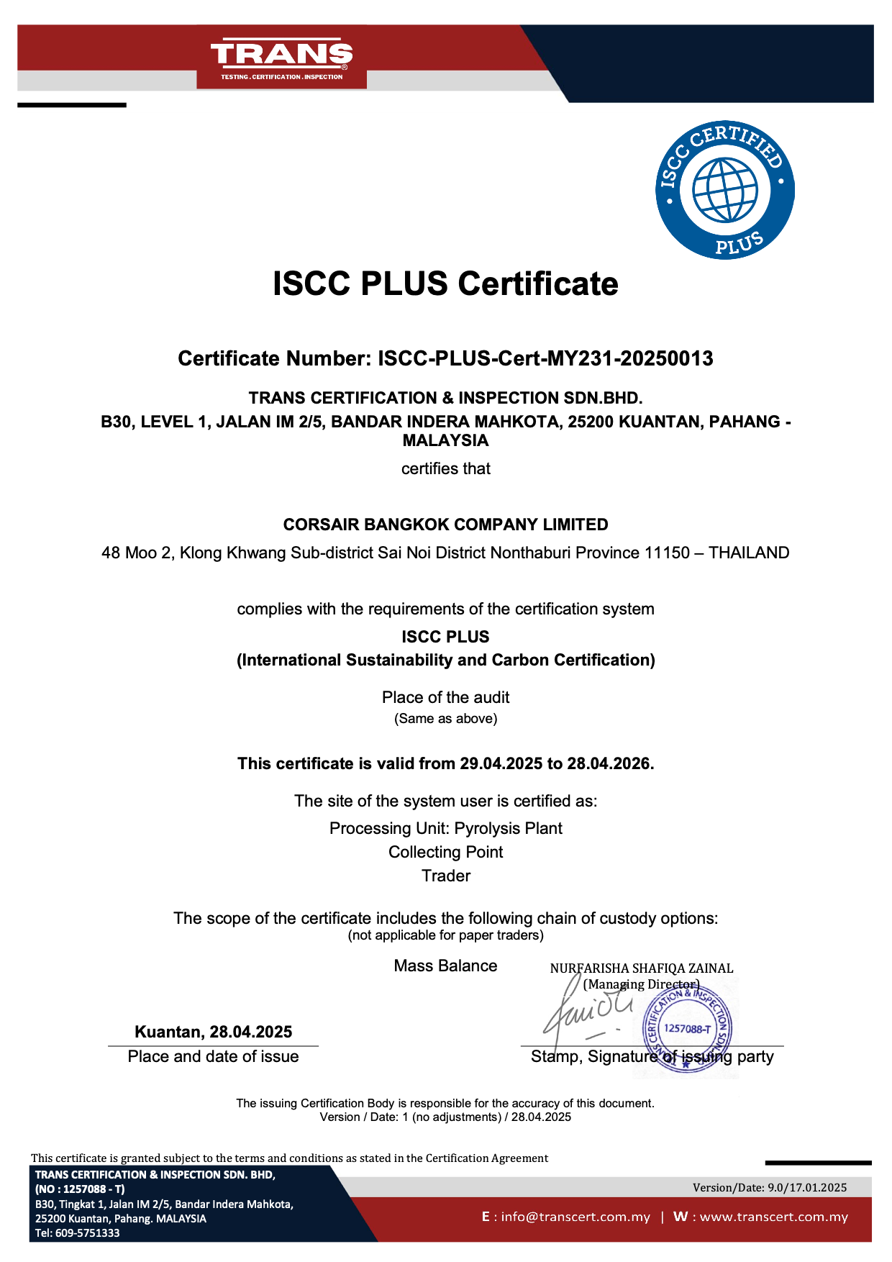
Corsair is certified ISCC Plus
This prestigious certification ensures and verifies that
a company meets globally recognised environmental
and social sustainability requirements.
Our clients, oil companies, want and need to buy advanced bio-oil from certified companies.
Plastic manufacturing companies are required by law to use recycled plastic in the production of new plastic.
There is thus a huge demand for advanced bio-oil.

Slide 10

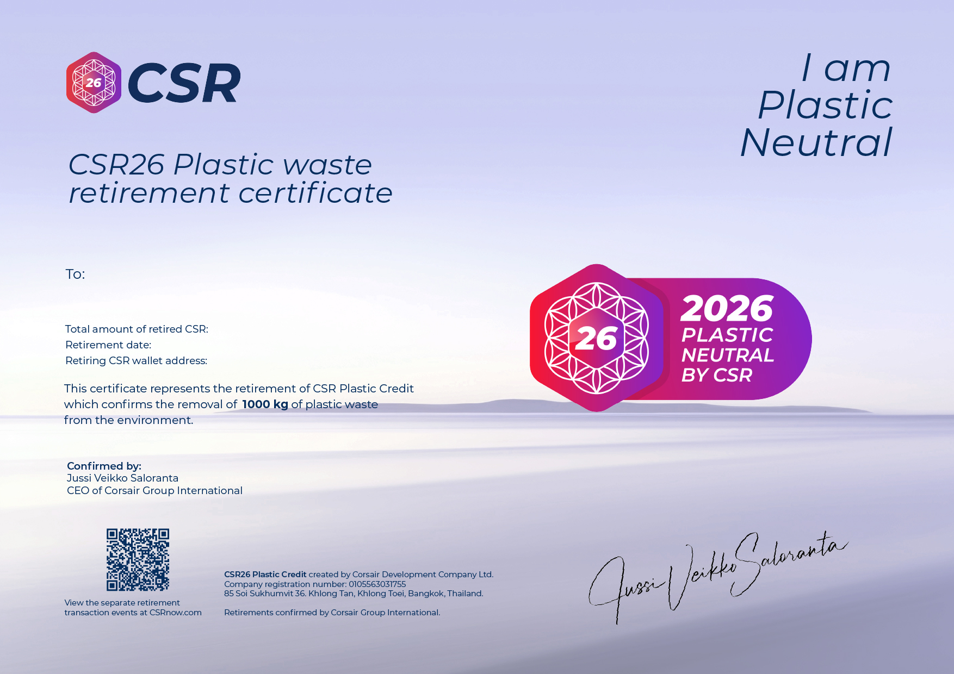
The revolution
The CSR Plastic Credit
Every time Corsair recycles plastic waste into advanced bio-oil, CSR26 plastic credits are distributed as a secure and traceable digital receipt.
Thanks to Corsair, individuals and companies can now offset their plastic pollution footprint and go Plastic Neutral by using CSR26 Plastic Credits.
More and more companies are taking their CSR (Corporate Social Responsibility) seriously
and becoming certified plastic neutral.

Slide 11
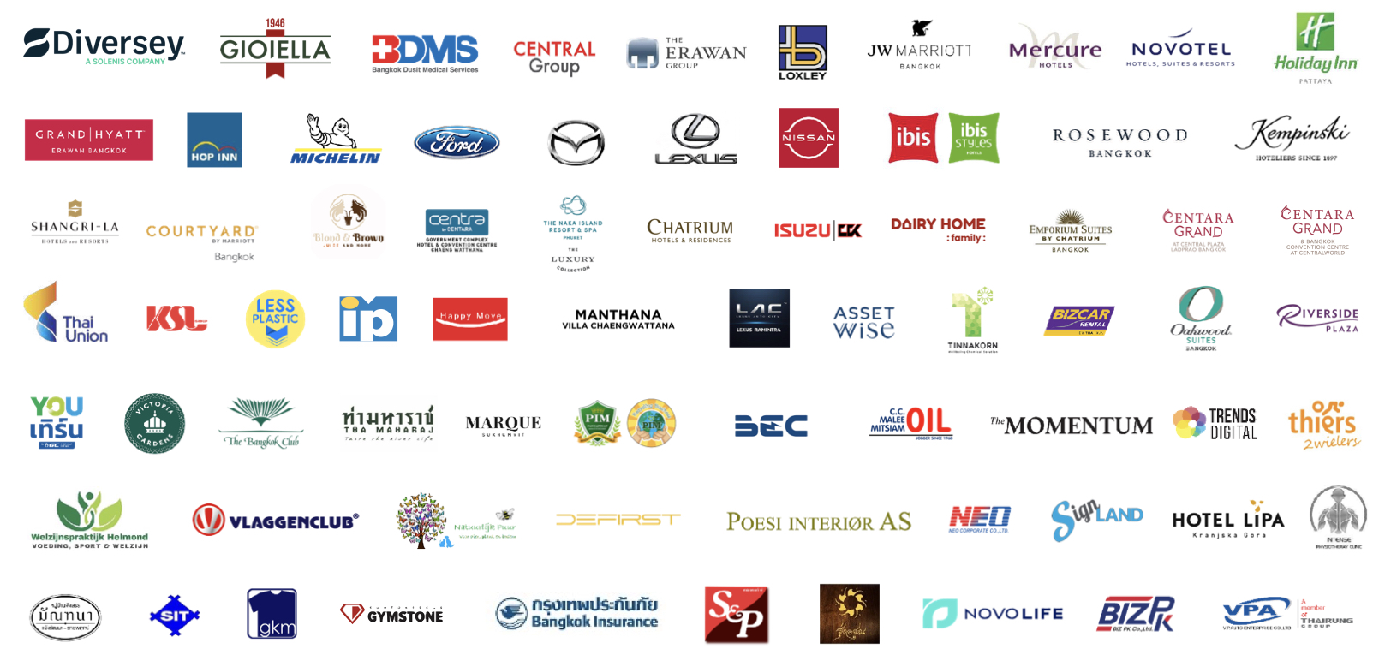
Corsair Group Partners

Slide 12
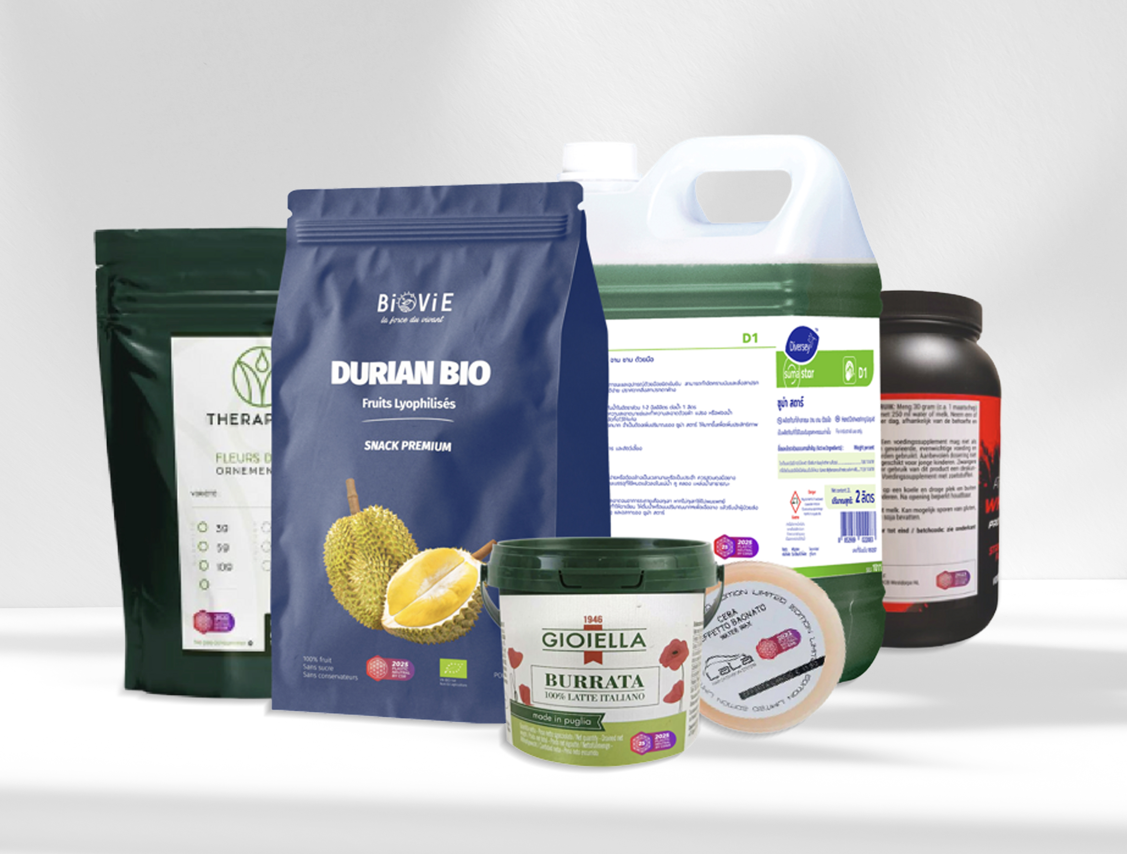

CSR26 PLASTIC CREDIT
ON PACKAGING
Corsair is perfectly positioned to take advantage of the new international legislation governing packaging
and Plastic Neutrality.

Slide 13

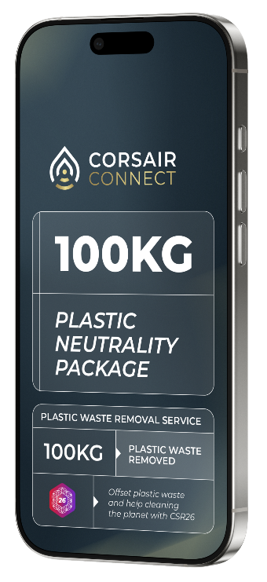


WHY IS THIS
INTERESTING
FOR YOU?
By purchasing a Plastic Neutral Package from Corsair Connect, you give an order to Corsair to remove plastic
waste from the environment and to convert it into
advanced bio-oil.
You then receive CSR26 Plastic Credits as a valuable
digital proof of depollution.
This means that not only can you have a global impact
on plastic pollution, but you will also become part of
an emerging global market, the plastic credit market,
with all its potential benefits.

Slide 14
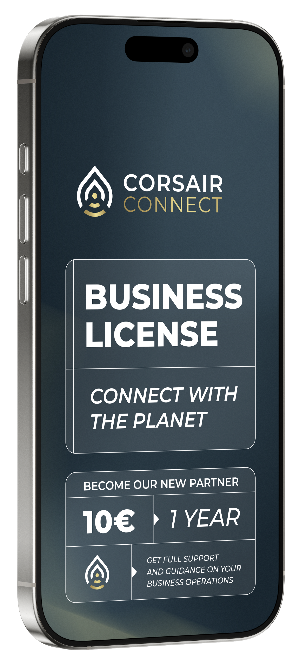
The OPPORTUNITY
THE CORSAIR CONNECT
BUSINESS OPPORTUNITY
When you help individuals and companies buy a plastic
waste removal package, you earn generous commissions
on the packages they buy.
Introduce other Corsair Connect Partners and earn commissions on the packages their customers buy!
Your Corsair Connect Business License costs only 10 € a year!

Slide 15
THE CORSAIR CONNECT COMPENSATION PLAN
Uni-Level
Bonus
Matching
Bonus
Infinity Star
Bonus
Earn 10 levels deep
on your Partners
Uni-Level Bonuses
Earn on your
team's turnover
Earn 5 levels deep
Levels 1: 12%
Levels 2-3: 8%.
Levels 4-5: 5%
Levels 1-4: 5%
Levels 5-7: 3%
Levels 8-10: 2%
Between 2-6%
depending on
your position

Slide 16

In conclusion
In conclusion
Corsair and Corsair Connect are on a mission to rid
the planet of the plague that is plastic pollution.
Corsair turns plastic waste into advanced bio-oil.
Corsair connect partners help people buy
the best plastic waste removal package for them.
You can earn generous rewards helping people
go plastic neutral!
Join us on our mission to save the world
for future generations.
Corsair and Corsair Connect are on a mission to rid
the planet of the plague that is plastic pollution.
Corsair turns plastic waste into advanced bio-oil.
Corsair connect partners help people buy
the best plastic waste removal package for them.
You can earn generous rewards helping people
go plastic neutral!
Join us on our mission to save the world
for future generations.

Slide 17

Start your
Corsair Connect
Business today
ONE MISSION
CONNECT WITH THE PLANET

