Slide 1
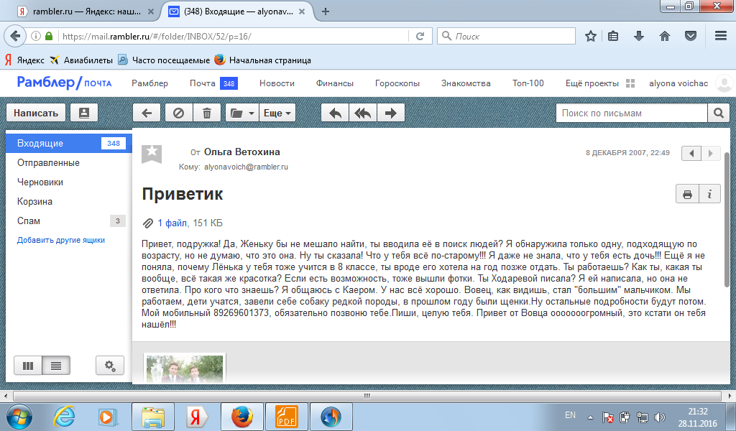
30th November
Dear friend,
I don’t know what to do. Can you help me?
At school we are doing projects on famous people from
different countries. I’ve already written about popular British football player David Beckham and now I should find the information about famous Russian people. Can you write me about some of them?
I hope to hear from you soon.
Best wishes,
Nick

Slide 2
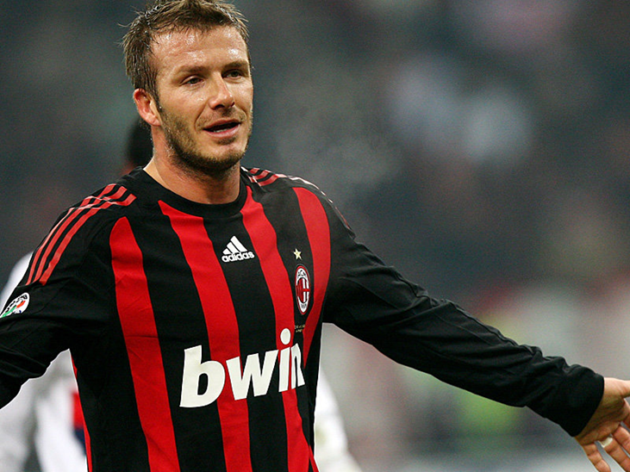

Slide 3
Схема структуры письма личного характера:

Slide 4
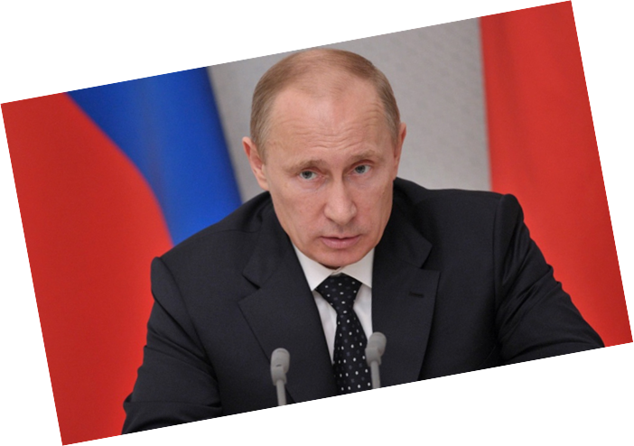

Slide 5
Facts about V. Putin
Full name: Vladimir Vladimirovich Putin
Is from: Leningrad, Russia
Date of birth: 7th October, 1952
Family: has two daughters
Hobbies: skiing, fishing, training sambo and judo
He can: speak English and German,

Slide 6
I can…
I can’t…

