Slide 2
Let’s make
our region
a better place!

Slide 3
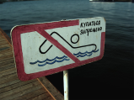
Match the problem and the sign
1. Water pollution
2. Air pollution
3. Litter
4. Deforestation
5. Endangered animals

Slide 4
Harmful to nature
to break trees
to leave litter
to throw litter in the river
to leave fire
to kill animals
to cut down baby trees
to pollute air with harmful gases
to dump industrial waste into water
Trees are broken.

Slide 5
should
shouldn’t
ask - просить
make do smth. - заставлять
forbid to do smth. - запрещать

Slide 6
Will brooms and shovels clean up the Arctic?
Blog entry by JulietteH | March 16, 2012 1 comment
New Zealand and Finland are practically on opposite sides of the planet, and quite a long way away from Alaska.... Read more >
Newsflash: #PeoplePower is challenging corporate madness, and winning!
Blog entry by Tommy Crawford | March 15, 2012 7 comments
“Consumers by definition, include us all. They are the largest economic group, affecting and affected by almost every public and private economic decision. Yet they are the only important group... whose views are often not heard.” ... Read more >
Mega coal mines threaten Great Barrier Reef
Blog entry by John Hepburn | March 14, 2012 2 comments
© Tom Jefferson/Greenpeace In our campaign to stop dangerous climate change, Greenpeace is taking on one of the most urgent issues: the enormous expansion of coal mining and coal exports from Australia. Read more >

Slide 7
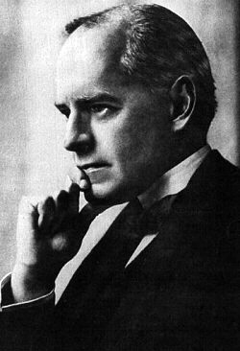
«If you don`t think
about the future
you will not have it»
(John Galsworthy )

