Slide 1
Parts of body
Презентацию выполнила
Войчак А.Ю.

Slide 2
Read and learn:
body

Slide 3
hair

Slide 4
head

Slide 5
nose

Slide 6
ear

Slide 7
mouth

Slide 8
eyes

Slide 9
tooth
(teeth)

Slide 10
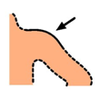
shoulder

Slide 11
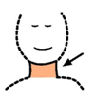
neck

Slide 12
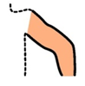
arm

Slide 13
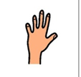
hand

Slide 14
foot
(feet)

Slide 15
leg

Slide 16
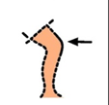
knee

Slide 17
Choose the right word:
eyes
mouth
nose

Slide 18
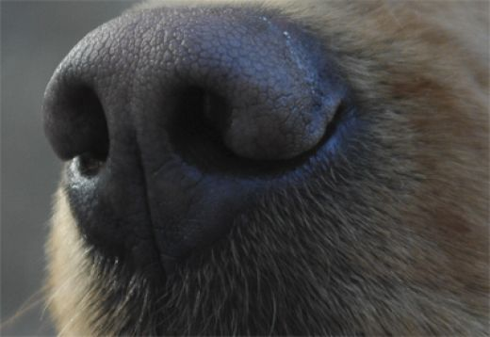
teeth
mouth
nose

Slide 19
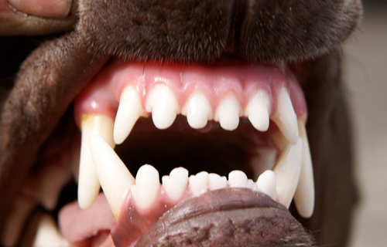
mouth
teeth
ears

Slide 20
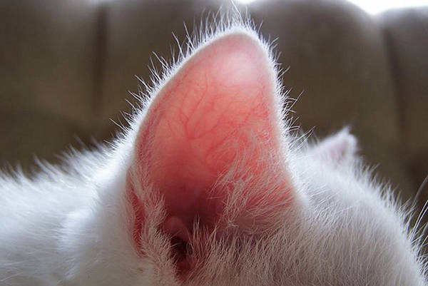
mouth
ears
feet

Slide 21
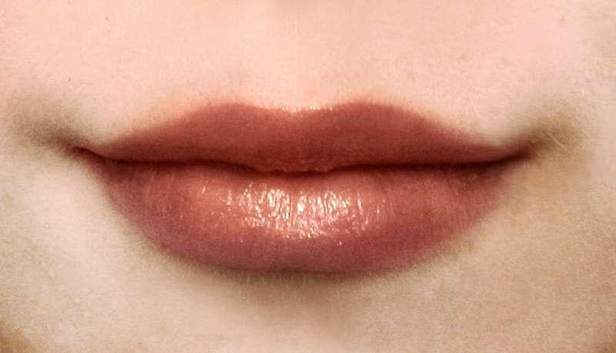
mouth
feet
hand

Slide 22
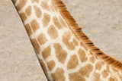
hand
neck
body

Slide 23
hands
arms
legs

Slide 24
feet
hands
arms

Slide 25
hands
body
head

Slide 26
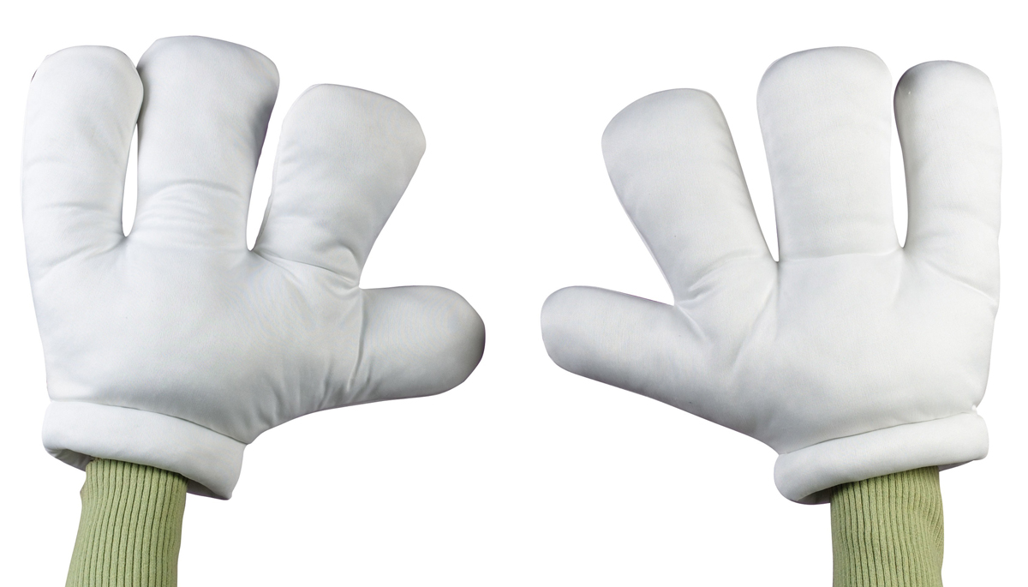
hands
body
knees

Slide 27
eye
head
name parts
of body:
hair
ear
shoulder
nose
neck
hand
arm
foot
leg

Slide 28
Complete the sentences:
head
nose
1. We have one ……… , one ………. , one ……… and one ………… .
2. We have two ……….., two ……… , two . . . . . . . . , two . . . . . . . . . . , two . . . . . . . . . . . ,two . . . . . . . . . and two. . . . . . . . .
3. A man has thirty-two . . . . . . . . . . . .
body
neck
eyes
ears
arms
shoulders
hands
legs
feet
teeth

Slide 29
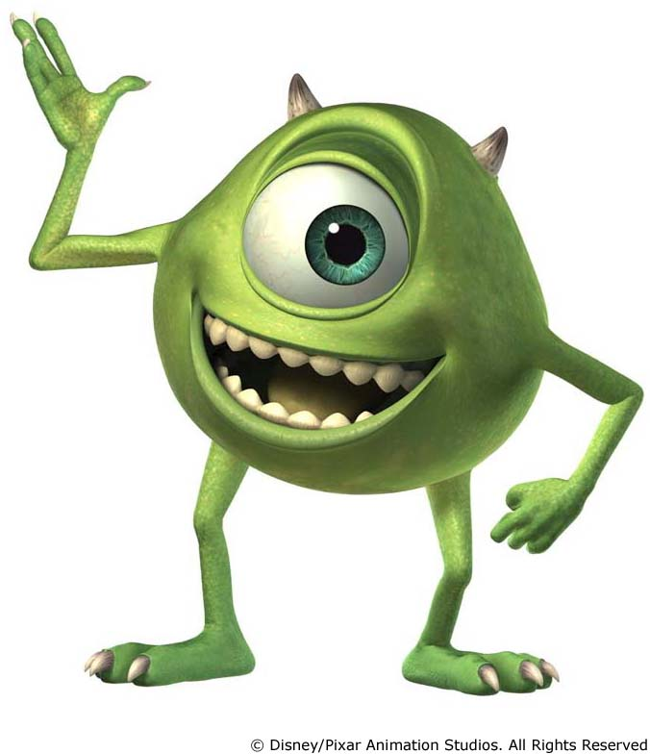
describe the monsters:

Slide 30
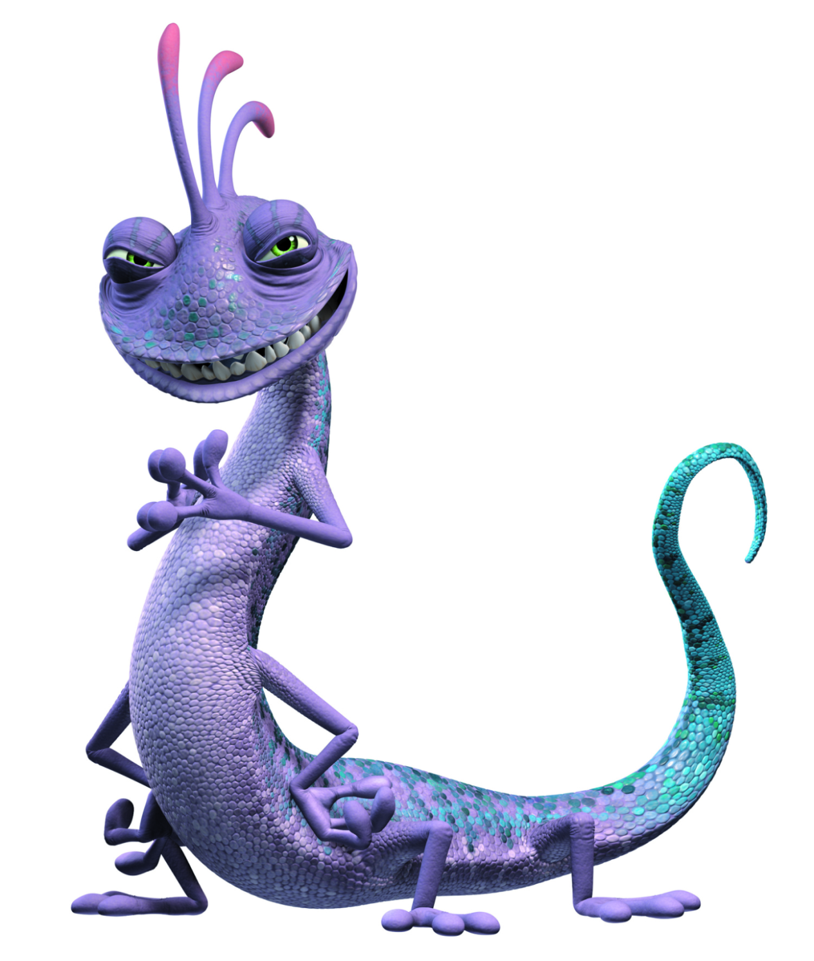

Slide 31
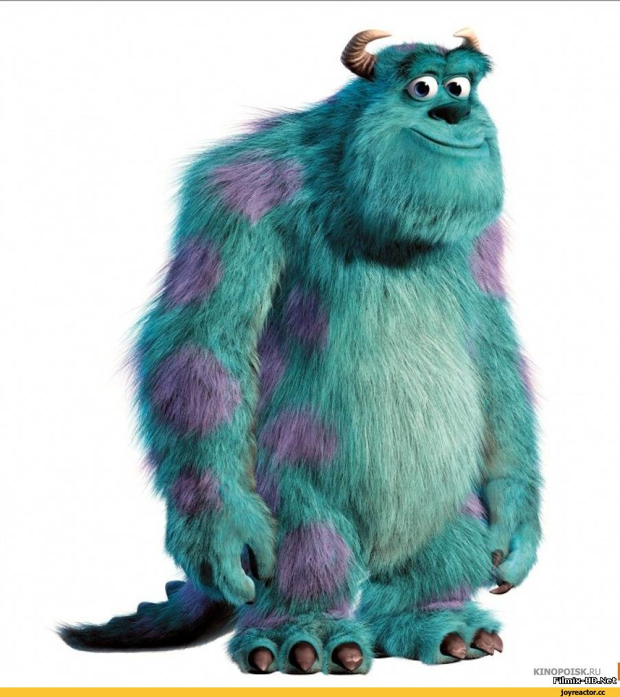

Slide 34
Использованные ресурсы:
http://rykami.at.ua
www.kinomania.ru
www.peeep.us
mimege.ru
www.peeep.us

